Slide 1


Strategic Growth and Revenue Stabilization: Enhancing Customer Retention and Inventory Management
Name : Sinan ameer s h
Roll No : 21f3000581
Business data
management project

Slide 2
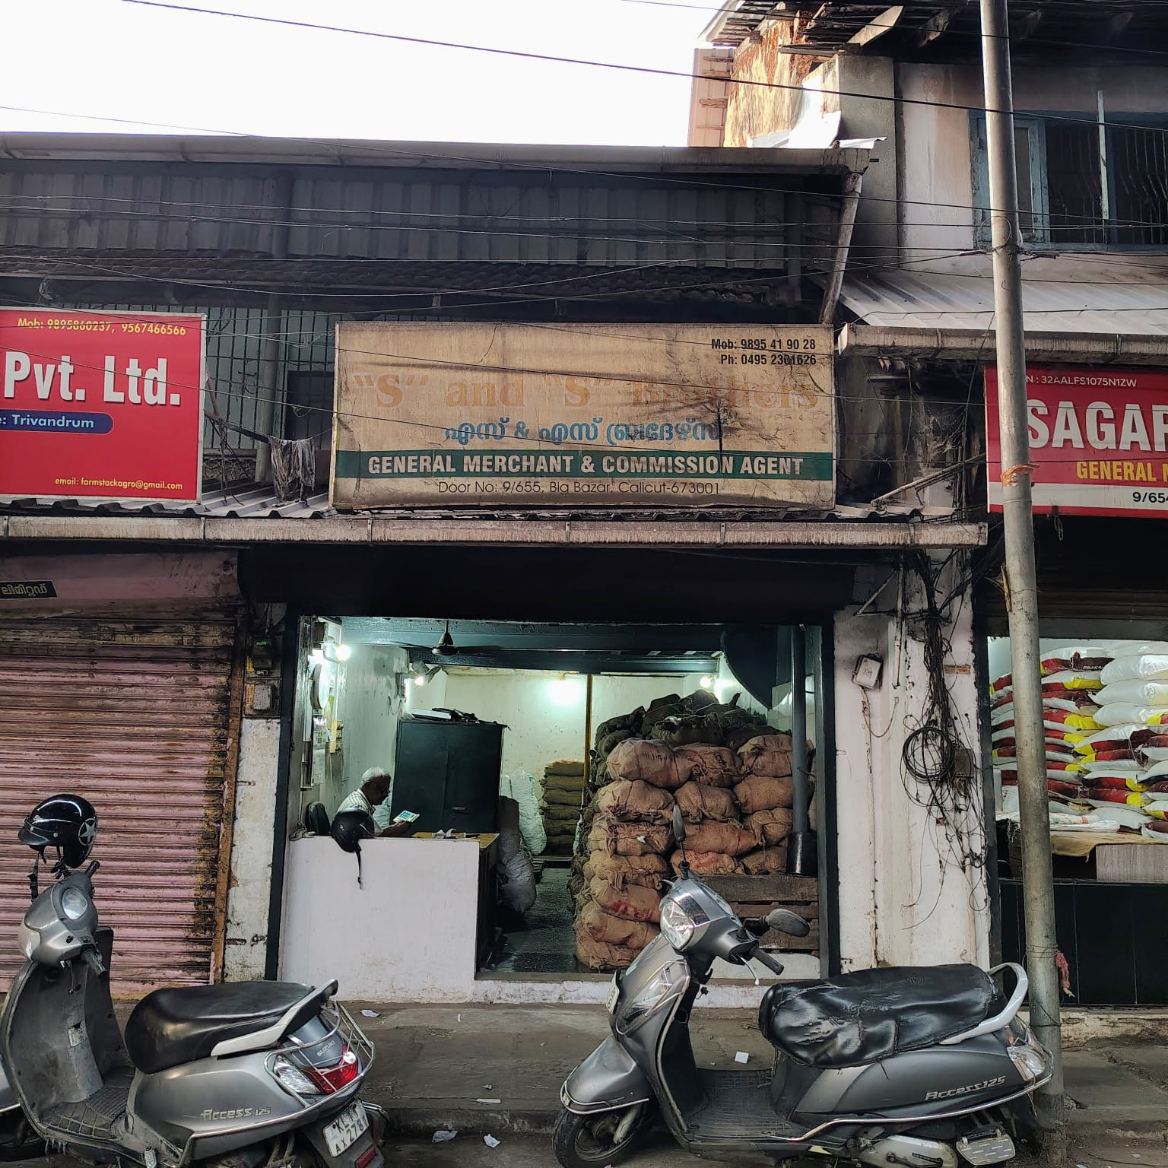
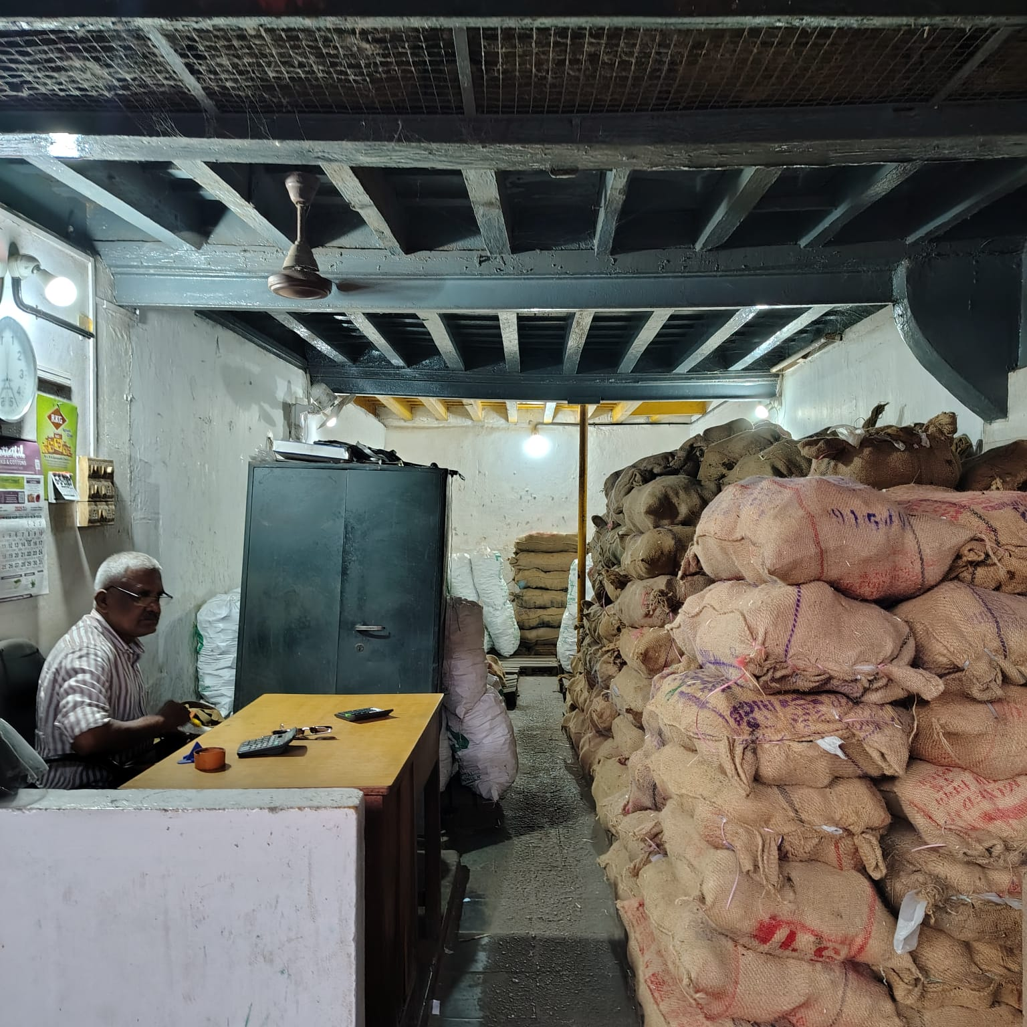
Organization Background
‘S’ and ‘S’ Brothers, a key wholesale dealer in jaggery, is located in Kozhikode Big Bazaar in Kerala. The business deals in B2B as well as B2C in the segment of ‘Food and Grains’ with an experience of more than 8 years.
The owner has over 25 years of experience in the jaggery trade. Before starting this venture, he was in a partnership business with his older brothers in the same industry.
‘S’ and ‘S’ Brothers offers high-quality, FSSAI-certified jaggery products, ensuring safety and compliance with food standards.
The venture has struggled with sharp revenue fluctuations due to inconsistent pricing and inefficient stock forecasting.

Slide 3
Problem 1 : Revenue Instability
Problem 2 : Inefficient Inventory management
due to price fluctuations and increasing customer churn
Inefficient inventory management has resulted in stock imbalances, where high-demand products run out quickly while slower-moving items accumulate, affecting cash flow and profitability.
Problem 3 : Weak Marketing
Problem 4 : Quality Issues
with multiple traders offering similar products. This intense competition forces businesses to constantly adjust pricing to retain customers.
The inability to maintain a consistent pricing strategy has resulted in customer loss to competitors offering lower prices.
Inconsistent jaggery quality due to supplier variations affects customer trust and retention.
The use of artificial colors and excess sugar to enhance appearance and shelf-life compromises product authenticity.

Slide 4
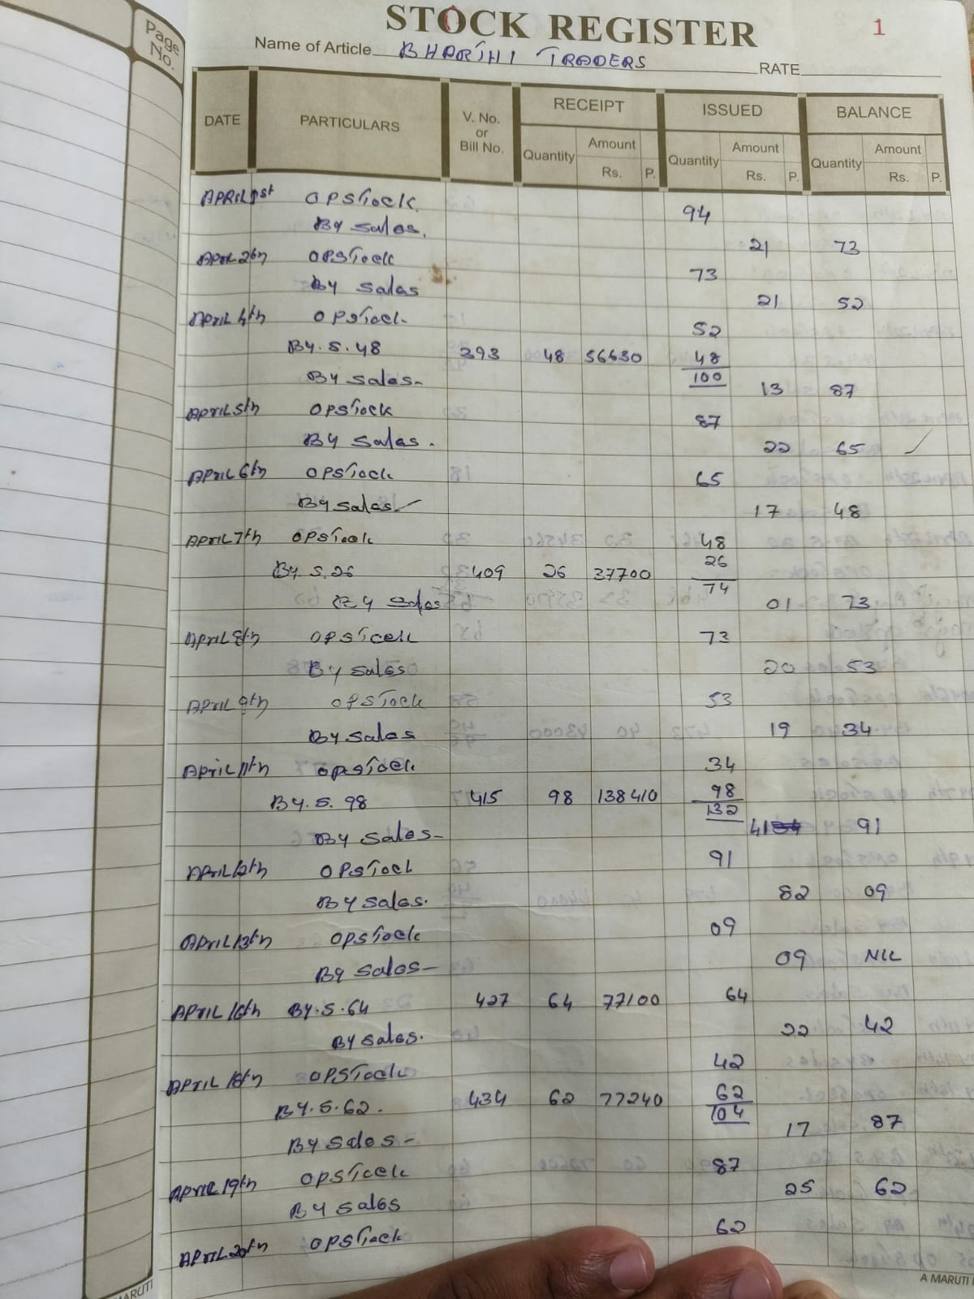
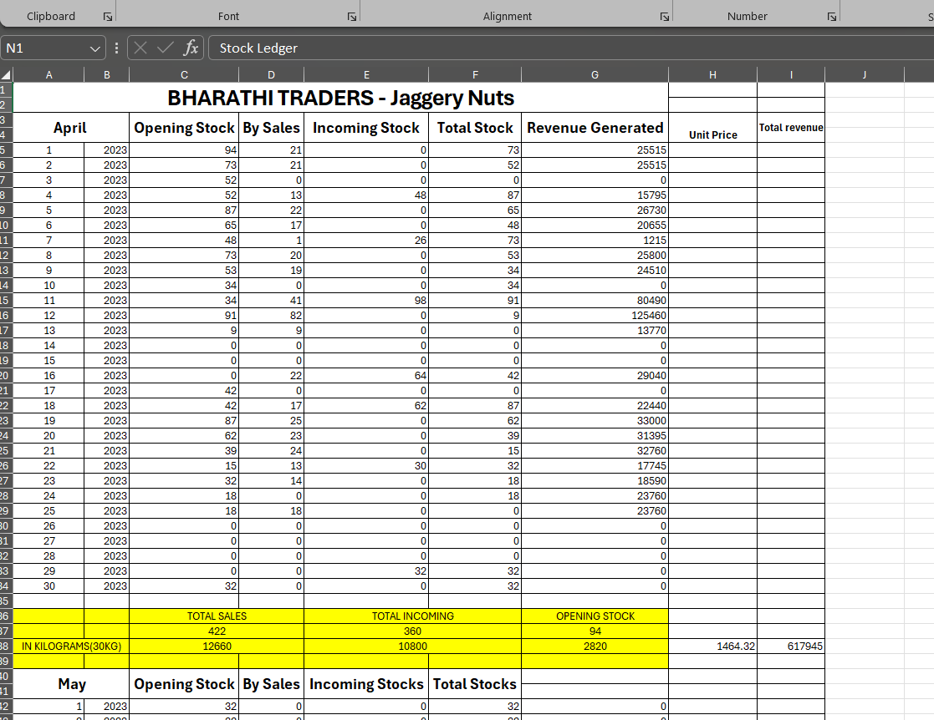
Data Collection
Primary Data
Stock Ledgers
Sales Registers
Bill book
Day book
The raw data comprised transaction-level sales and inventory logs for a year(April 2023 – March 2024). Initial steps involved consolidating daily records into a master dataset. The data sources can be accessed through the link mentioned below:
Stock Ledger
Competitor Pricing data was also collected through direct market intelligence.
Excel and Python (Google Colab) were used for data cleaning and initial analysis.

Slide 5
Methodology Used:
Descriptive Statistics
Mean, median, standard deviation, minimum, maximum for monthly sales, revenue and average unit price by each SKUs were calculated.
This helps prioritize products, identify weaknesses in revenue streams, and design targeted strategies for growth and stabilization.
Example:
Bharati Traders(Jaggery Nuts): has a high mean but also high std and months with zero sales, indicating risk and volatility
Time Series Analysis
Sales, revenue and price data were visualized across time using line and bar charts to identify seasonality and volatility. This approach clarified months of peak versus low demand, supporting targeted interventions.
This guides to focus working capital, shelf space, and promotions on high-impact SKUs directly reducing inventory inefficiency and wasted capital.
3. ABC Categorization
ABC Analysis is an inventory management technique.
Categorizes based on the volume of sales or revenue generated over the year.
Based on this each SKUs are categorized in to 3 categories A,B and C.
A Category: typically, top 70–80% of value.
B Category: next 15–20%.
C Category: bottom 5–10%.
4. Competitor Pricing Analysis
For each of the main products (SKUs), competitor prices were collected monthly, via direct market intelligence.
These prices were tabulated alongside the company's average unit selling price.
Stock Return Analysis
Stock returns indicate the quantity of jaggery products that were brought back from customers, often due to defects or quality issues.

Slide 6
Findings – ABC Categorization
“A” category SKUs(Sri Vengadesh – Jaggery balls, Bharati – Jaggery nuts) contribute over 50% of total revenue and sales.
“B” category SKUs(SJB – jaggery nuts, Sri Dharani – Jaggery balls) adds significant but moderate value.
These require the most stringent inventory control, price monitoring, and promotion focus.
Sri Vengadesh Perumal – Jaggery balls contributes highest in terms of revenue as well as sales, contributing ₹55,06,300 to the revenue and 3987 in sales volume.
“C” category SKU(Reshma – Jaggery nuts) has minimal impact, represents slow movers.
Reshma traders – Jaggery nuts has minimal impact in revenue and sales, potential candidate for inventory reduction or clearance.

Slide 7
Findings – Sales & Price Trends
Sales volumes for the major SKUs show clear seasonality and volatility:
Example: Bharati Traders – Jaggery Nuts experienced a dramatic sales spike in July but then sales declined sharply, reaching zero in February and March, even when there was available stock.
Sri Jaya Bharati Traders and others also show irregular sales, with months of high peaks and others with little or no activity.
The number of “no sales days” is a critical operational issue for all products, particularly some SKUs that remain unsold for large parts of the year.
Focusing on understanding the seasonality patterns and minimizing no-sales days is essential for stabilizing revenue and improving stock turnover.

Slide 8
Findings – Competitive Pricing
Based on Competitor Pricing : Example BHARATI – Jaggery nuts
These show “Price Comparison” between client vs competitor for Bharati – jaggery nuts.
Similarly, the comparison is also available for SJB – Jaggery nuts.
When the client prices align with or undercuts the competitor, sales volumes are higher.
These figures best illustrate the direct relationship between pricing position and sales volume, making the price sensitivity clear.
Even small price differences (2-3%) cause sharp sales drop, confirming high price sensitivity in the market.
Tight alignment with competitor pricing is critical for defending and growing sales, hence customer retention.

Slide 9
Interpretations
Revenue & Sales Instability
• Key SKUs like Bharati – Jaggery nuts and SJB – Jaggery nuts experience significant volatility, with sales spiking during festive seasons, often dropping to zero in some months.
• This reflects high exposure to seasonality, pricing and competition.
2. Inventory Challenges
Frequent “no sales days” and long periods of inactivity point to both stock outs and overstocking.
Efficient inventory planning is lacking, causing missed opportunities and cash flow.
SKUs like Sri Dharani - Jaggery balls and Reshma - Jaggery nuts are overstocked with higher ratio of no sales to sales days.
3. High Price Sensitivity
•Sales volumes are highly responsive to even small changes in pricing compared to competitors(SKUs Bharati and SJB).
•Months were prices exceeded competitors led to sales drop, highlighting the importance of real time pricing strategy.
4. Product Quality Concerns
• Elevated and volatile product return rates(SKU – Reshma - Jaggery nuts) indicate inconsistent quality, possibly from supplier, which negatively impacts customer trust and revenue.

Slide 10
Recommendations
Implement Dynamic Pricing:
• Leverage competitor pricing tools to adjust prices keeping “A” category products within a 1-2% range below competitors to maximize sales and reduce churn.
Adopt Data-Driven Demand Forecasting:
• Use past sales data, seasonality, and event mapping to set monthly or weekly inventory targets for each SKU. • Automate replenishment reminders and set minimum stock thresholds for “A” SKUs (Sri Vengadesh – jaggery balls and Bharati – jaggery nuts). • Achieve less than 10% stock-out days and under 15% overstock days for A and B products within the next sales year
Focus on High-Impact SKUs (ABC Analysis) :
• Consolidate and Prioritize A and B Products: Focus marketing, inventory, and pricing efforts on “A” and “B” SKUs, reducing procurement frequency and working capital tied up in “C” SKUs.
• Maintain 90% stock availability of “A” products and reduce procurement of “C” products by 15-20% over one year.
Strengthen Supplier Quality:
• Introduce batch-wise quality checks, especially for high product return SKUs (“C” Category: Reshma – jaggery Nuts).

